Slide 1
Data Science Capstone Project Summer 2021 Team #02: Zhongdi Wang Vy Kiet Le

Slide 2
Table of Contents
Problem statement
Our solution approach
Data exploration and cleaning
Feature engineering
Modelling techniques
Summary of the models and their results
Model used for prediction: XGBoost
Visualization of prediction results
Improvement initiatives and future work

Slide 3

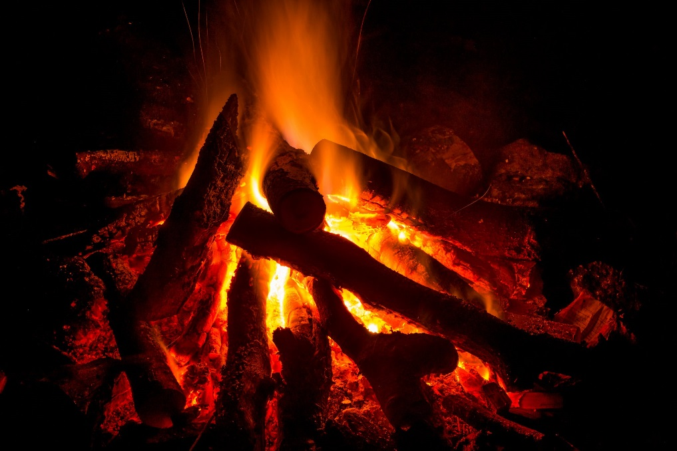
Problem Statement
Context
The city of Montreal is tasked with interventions on many levels to help protect lives and properties. One of the events that cause the most damage is undoubtedly when an apartment of a building catches fire and spreads it to other neighboring units.
Along with the city of Montreal, the firefighters of the SIM and the managers in charge of the fire prevention planning want to predict fire risk and distribute resources to areas in the city that most need it.
Problem
One of the biggest challenges that the city has faced in the fire prevention is to create the right model that would predict high fire risk areas and allocate the necessary resources to those areas for fire inspections and for taking appropriate fire intervention measures.
Solution
The goal of our team project is to predict fire risk level for each area delimited by the administrative limits in the city of Montreal for the next months.

Slide 4






Our solution approach
Data source
Data preparation
Output merged file
Modelling
Visualization
Dataset A: Interventions
Dataset B: Fire stations
Explore and analyze the data for outliers
Add new field to indicate which intervention is considered as Fire incident based on description
Aggregate data based on areas in Montreal city and on a monthly basis
Merge datasets
Features selection
Evaluate model performances
Model 1 : k-nearest neighbors
Model 2 : Support Vector Machine
Model 3 : Random Forest
Model 4 : XGBoost
Predict fire risk level in each area
Visualize fire risk level prediction for a given area of Montreal for the next months
Dataset C: Crime Incidents
Dataset D: Property Assessment
Dataset E: Administrative Limits of Montreal Area

Slide 5
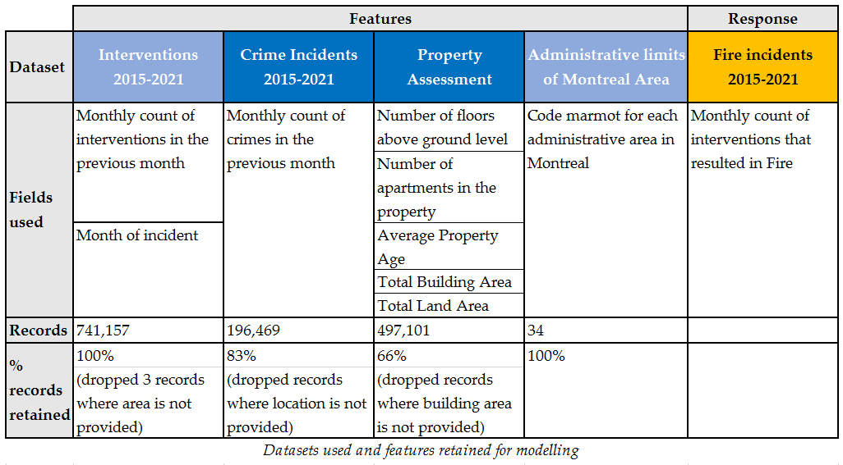
Data exploration and cleaning
Crime Incidents 2015-2021:
We have included crime incidents in our model because we believe that a fire can be a result of any type of crime incidence.
Property Assessment:
We have also included details on the properties in the city of Montreal because we believe that fire occurrence is relatively higher in administrative areas with huge property land area and higher number of accommodations.
Fire incidents 2015-2021:
Among the types of interventions classified by the city, we refer to a fire incident when the intervention is described either as “Incendie” or “Autre feu”.

Slide 6
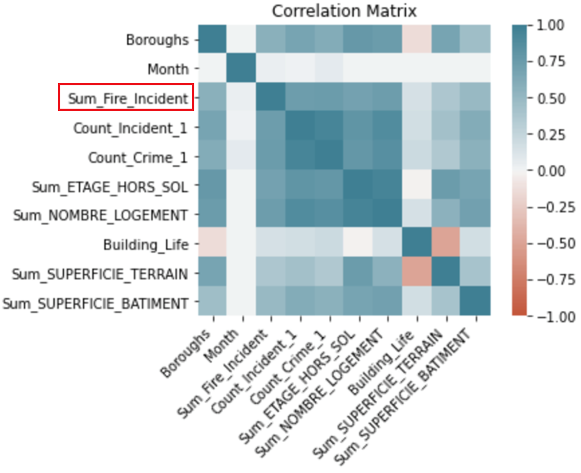
Feature engineering
Correlation Matrix
High correlation between the fire incidents count and the variables such as number of interventions in the previous month, number of crimes in the previous month, number of building floors above ground as well as number of accommodations.
Feature engineering:
Average Property Age:
For each administrative area in Montreal city, we have calculated the average life of all the buildings and properties within that area.
Month of incident
We add a new field for the month of the incidents (intervention, crime) to aggregate the data based on borough and month/year.
Lag features (interventions, crimes):
We have introduced two variables, which are the counts of interventions and of crimes in the previous month. Under the belief that places with a history of interventions and crimes, fire incidents can have a higher probability of occurring in the future.

Slide 7
Modelling techniques
Categorization of the fire risk: based on number of fire incidents per area per month, such that we get approximate same number of fire incidents across the levels
Count of Fire incidents | Fire risk level
[0, 2] | 1 (low)
[3, 15] | 2 (medium)
>15 | 3 (high)
Simple encoding: convert areas/boroughs into numerical value before feeding the feature in the models
Normalization: bring all numerical fields to use a common scale

Slide 8
Summary of the models and their results
Model | Decision Trees (DT) (Baseline) | Random Forest (RF) | K-Nearest Neighbors (KNN) | Support Vector Machine (SVM) | XGBoost (XGB)
Accuracy | 74.4% with an R-score of 0.528 for a model based on 3 features | 78.4% with an R-score of 0.588 for a model based on 5 features | 78.4% with an R-score of 0.588 for a model based on all 9 features | 70.1% with an R-score of 0.488 for a model based on 4 features | 80.5% with an R-score of 0.627 for a model based on 7 features
Advantages | Generally fast training time and simple tool. | Generally fast training time and simple tool. Decorrelate trees to reduce variance of predictions. | No training period before making predictions Easy to implement | Works well if there is clear margin of separation between classes | XGBoost performs very well on small dataset with subgroups and structured datasets with not too many features
Disadvantages | Can overfit data and slow down predictions if there is a large number of trees in the algorithm | Can overfit data and slow down predictions if there is a large number of trees in the algorithm | Does not work well with large datasets (slow performance) Does not work well high dimensions (features) | Not suitable for large data sets Does not perform well if target classes (fire risk levels 1-3) overlap | Does not perform so well on sparse and unstructured data

Slide 9
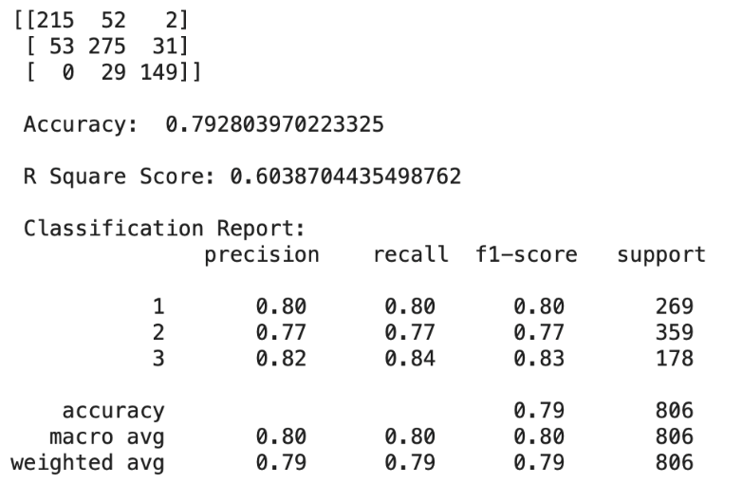
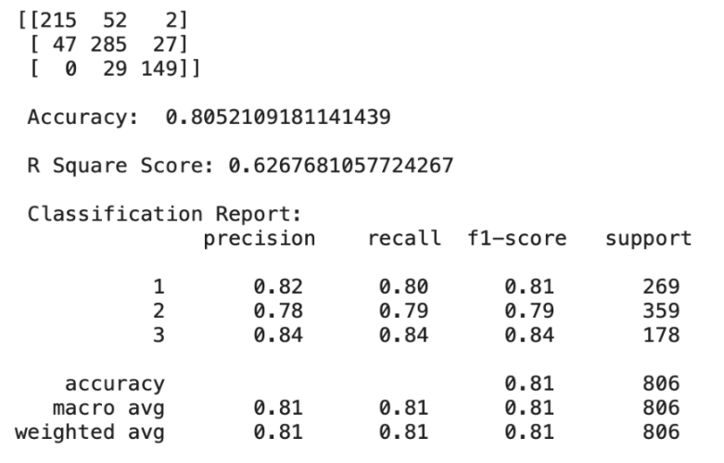
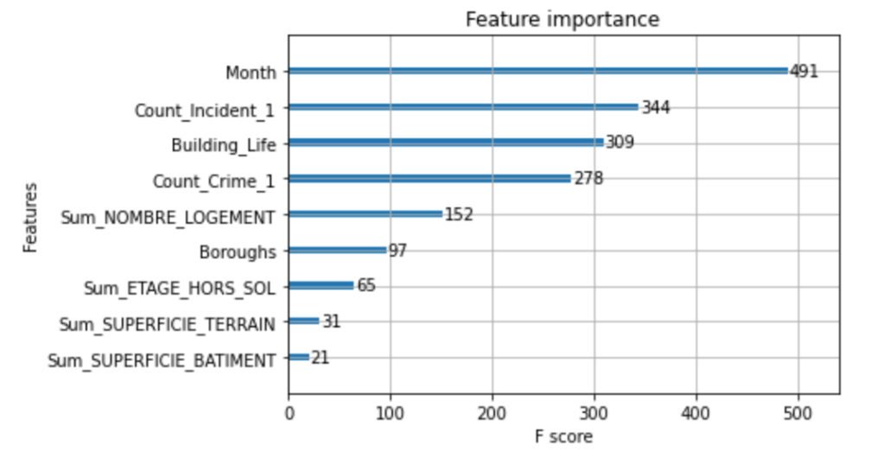
Model used for prediction: XGBoost
Evaluation metrics
We initially used all the 9 features that we believed are relevant in predicting fire risk level. The accuracy achieved was 79.3% with an R-score of 0.604.
After parameter tuning and using sklearn.feature_selection.SelectFromModel in Python, we reduce from 9 features to 7 based on the feature importance to the model. The accuracy achieved was then 80.5% with an R-score of 0.627.
The 7 features retained by the model are:
Month
Number of interventions
Building Age
Number of crimes
Total number of accommodations
Boroughs
Total number of building floors
XGB (9 features)
XGB (7 features)

Slide 10
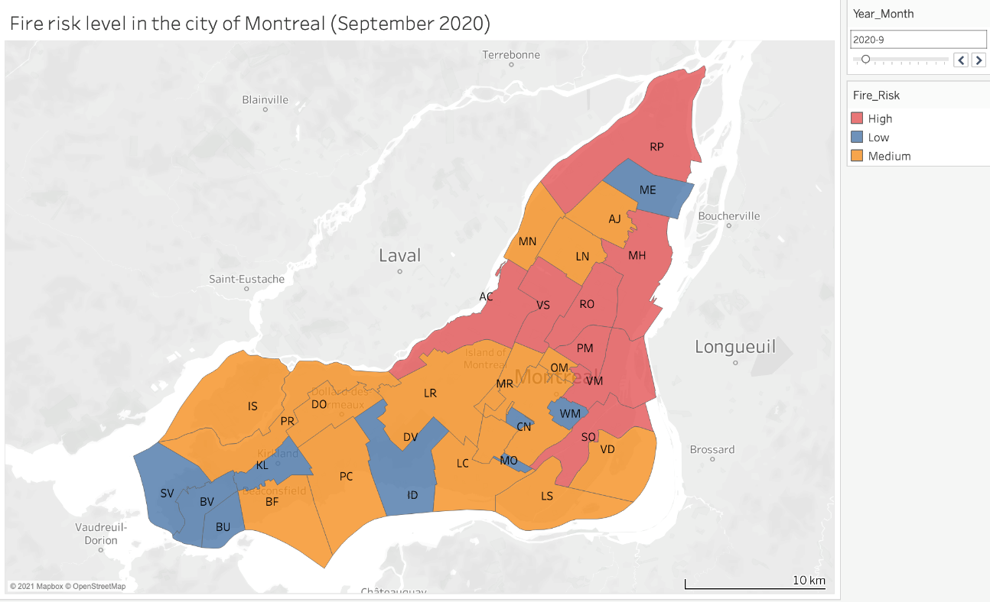
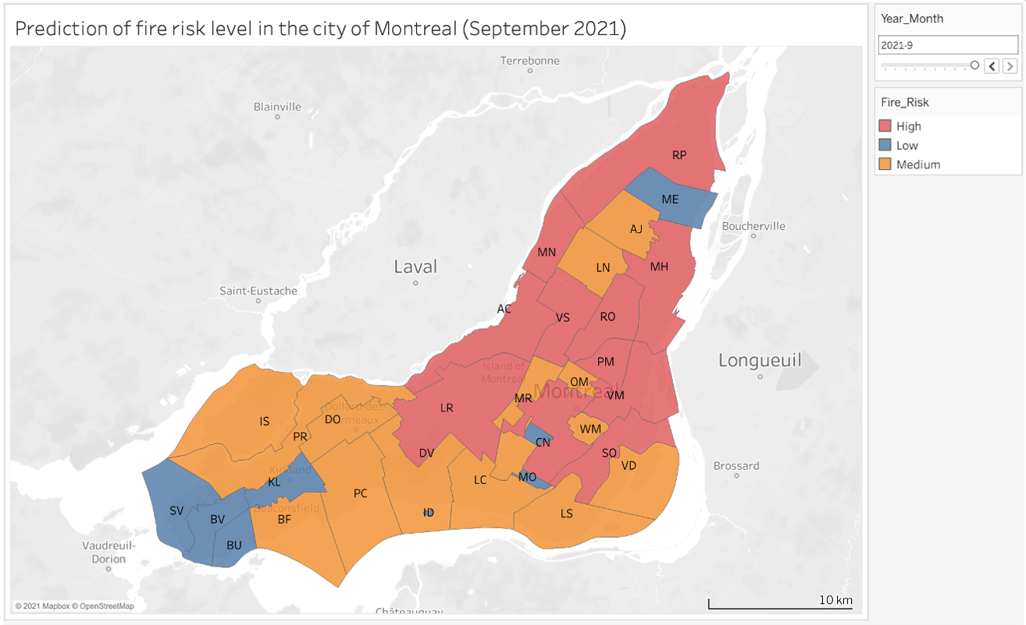
Visualization of prediction results
Historical Data
Predicted Data
As depicted in the above results:
areas LR, CN and MN have changed from Medium risk to High risk this month of September one year later
areas DV and WM have changed from Low risk to Medium risk this month of September one year later

Slide 11
Improvement initiatives and future work
Explore more features from new datasets which may be more relevant to the fire risk, such as population of borough, education level, etc.
Spend more time on feature engineering which helps select better feature to improve model performance.
Consider other potential classification models to increase the chance of having a better prediction result.
In the fire risk categorization, consider the size of areas/boroughs to compare the risk as the same number of fire incidents may have a different impact on boroughs with different sizes. For example, consider the dissemination blocks of 1 km².
The severity of the incident may also be taken into consideration in the analysis. An area with low fire risk assigned by the model could have a high severity calculated in terms of significant loss of life and property damages.
Consider the number of fire stations in each borough to help stakeholders better manage their resources.

Slide 12
Thank you!

